Slide 1


AcTree :
Take a step and let the future immortalize your actions
Team: EMIcatronic

Slide 2
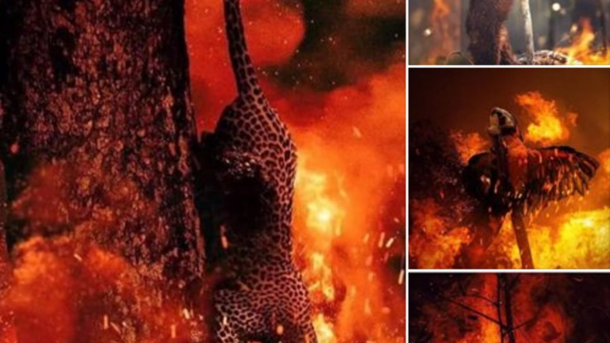
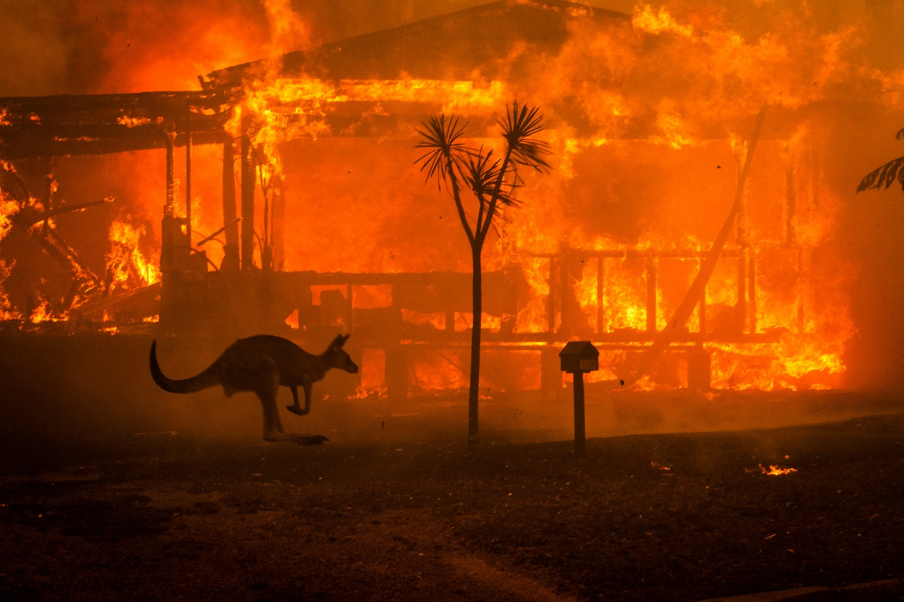
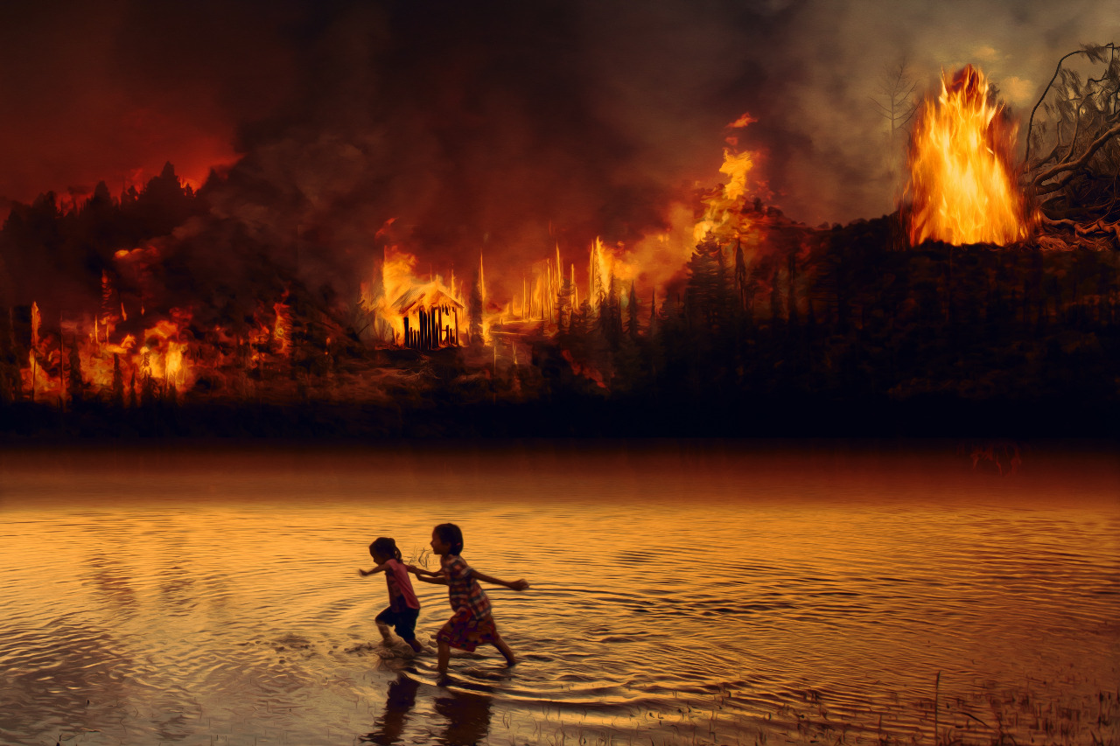
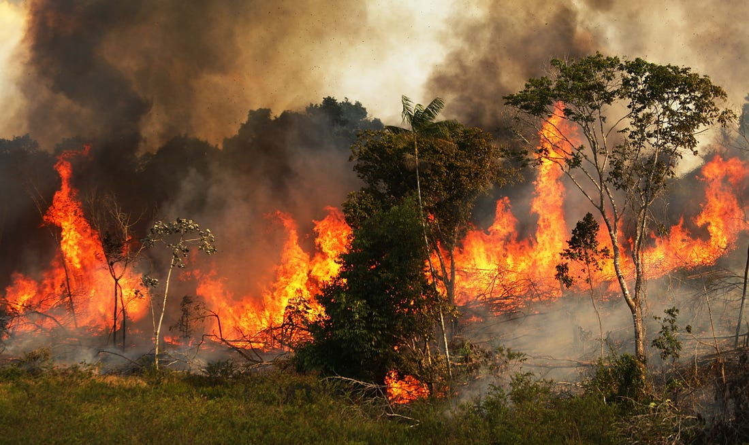
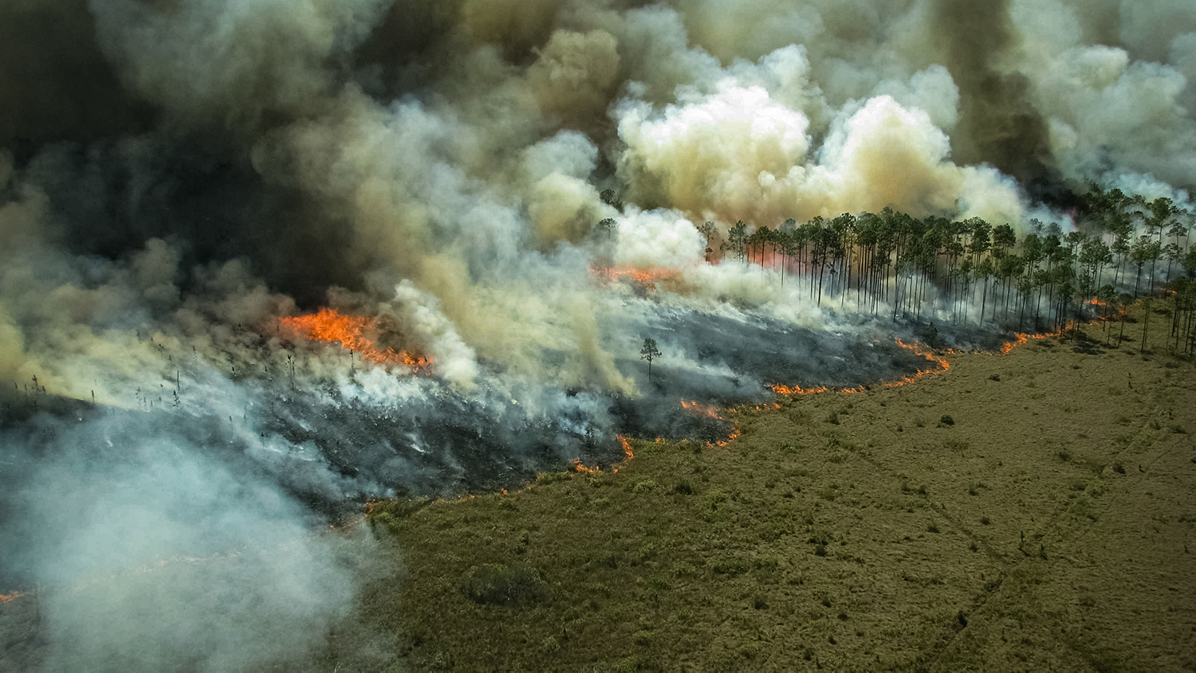

Slide 3
PROBLEM

Slide 4


PROBLEM
~5M
25%
3%

Slide 5

PROBLEM
25%
0,04%

Slide 6

PROBLEM
?
!
?

Slide 7

SOLUTION

Slide 8

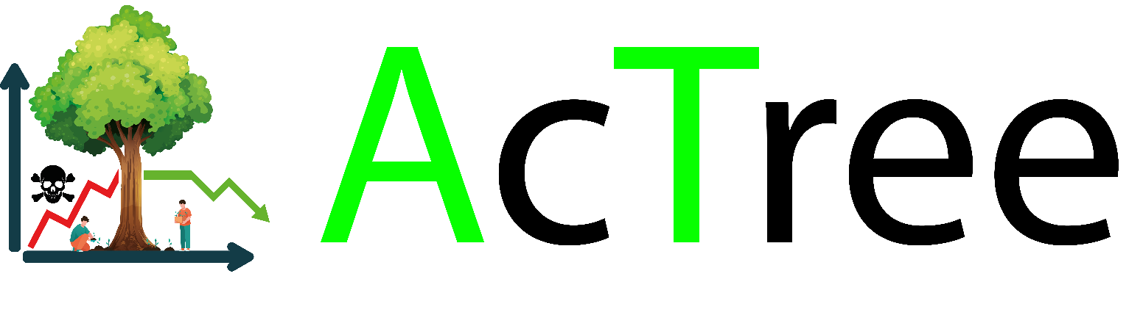
SOLUTION

Slide 9

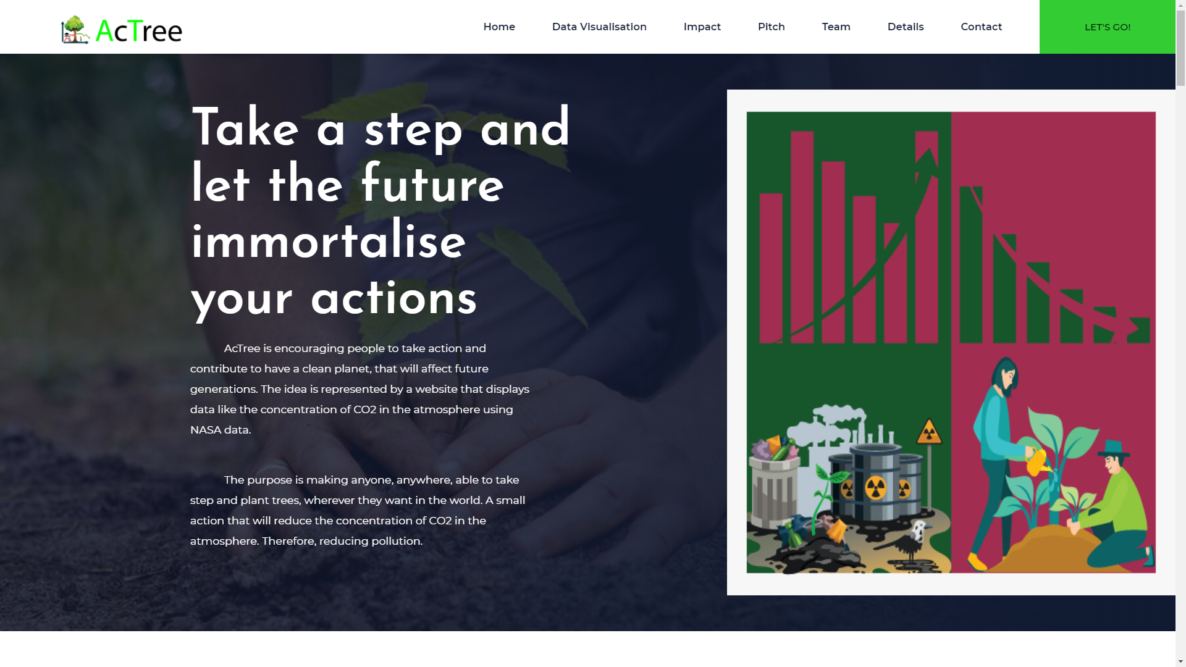
SOLUTION

Slide 10
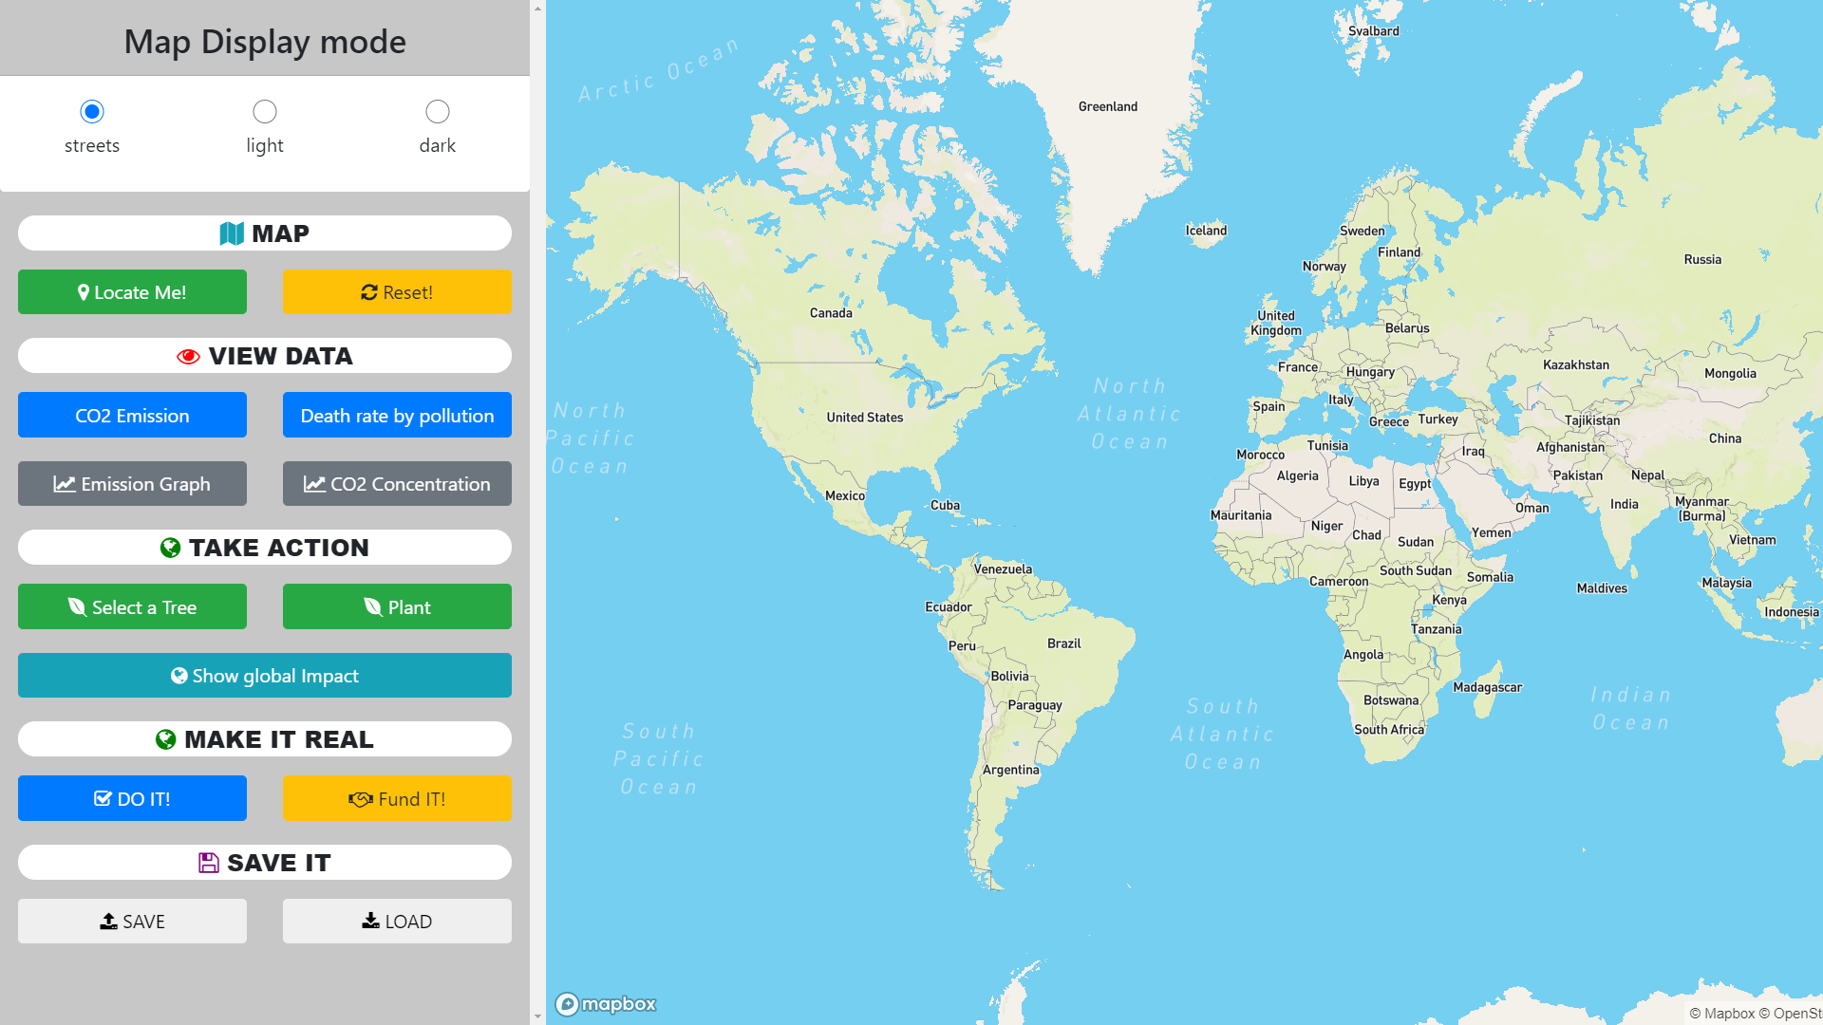
SOLUTION

Slide 11
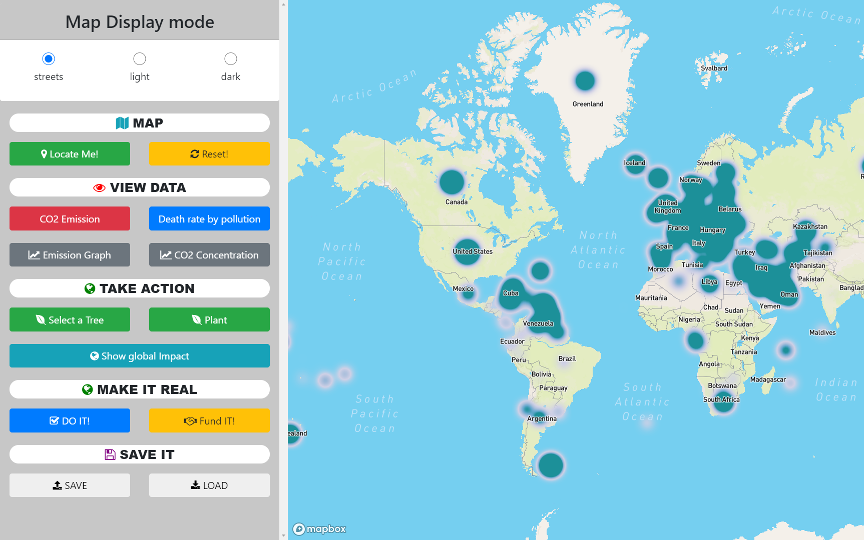
SOLUTION

Slide 12
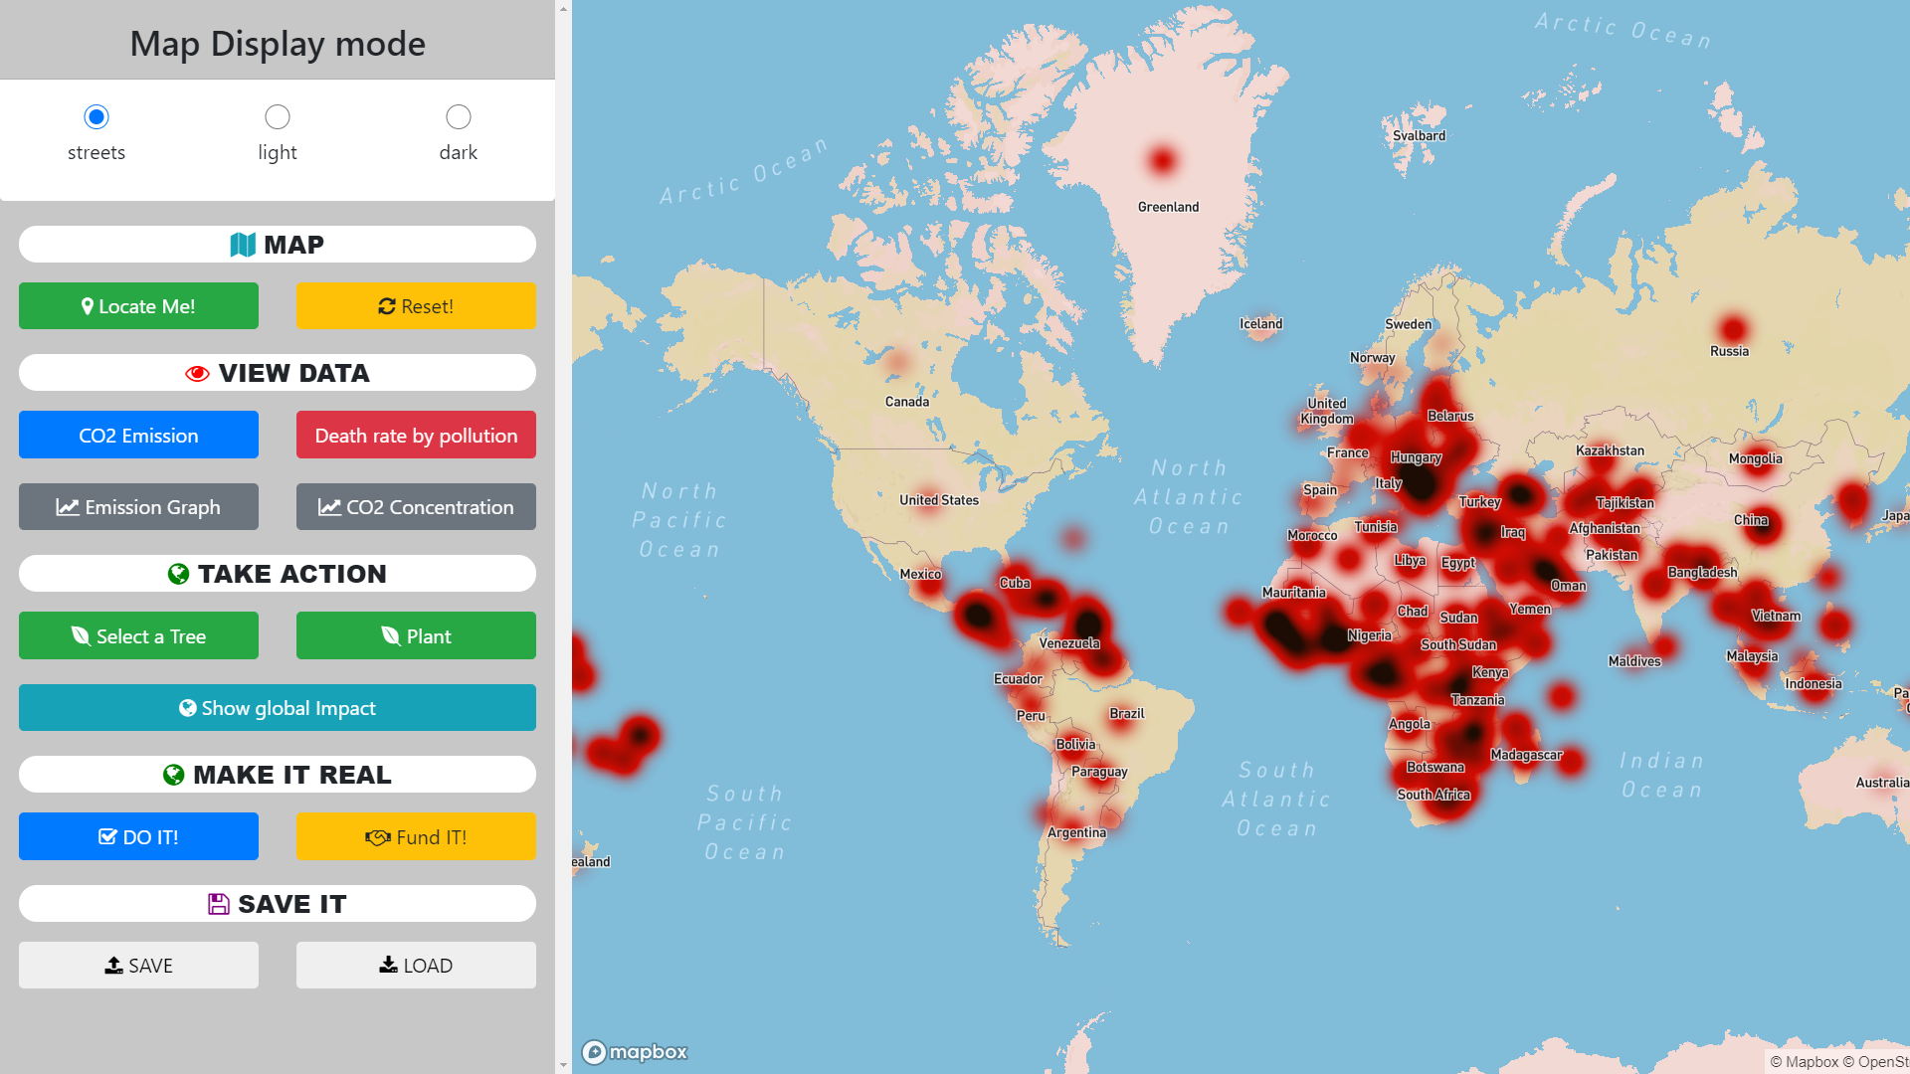
SOLUTION

Slide 13
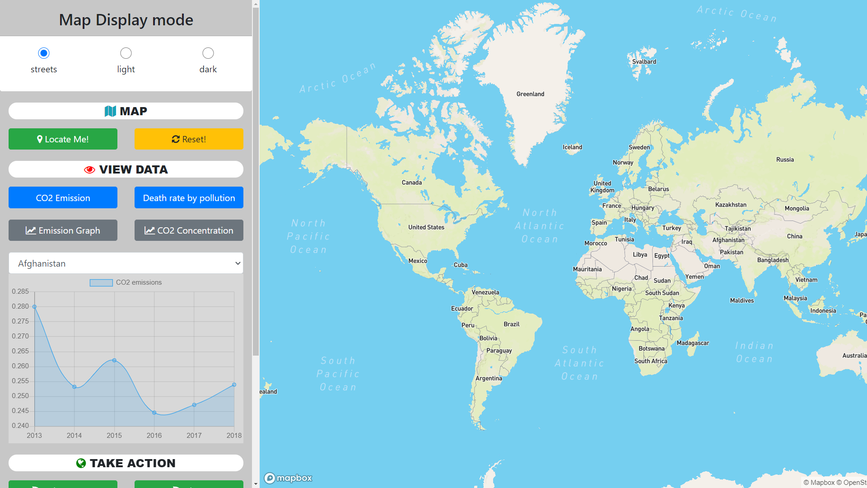
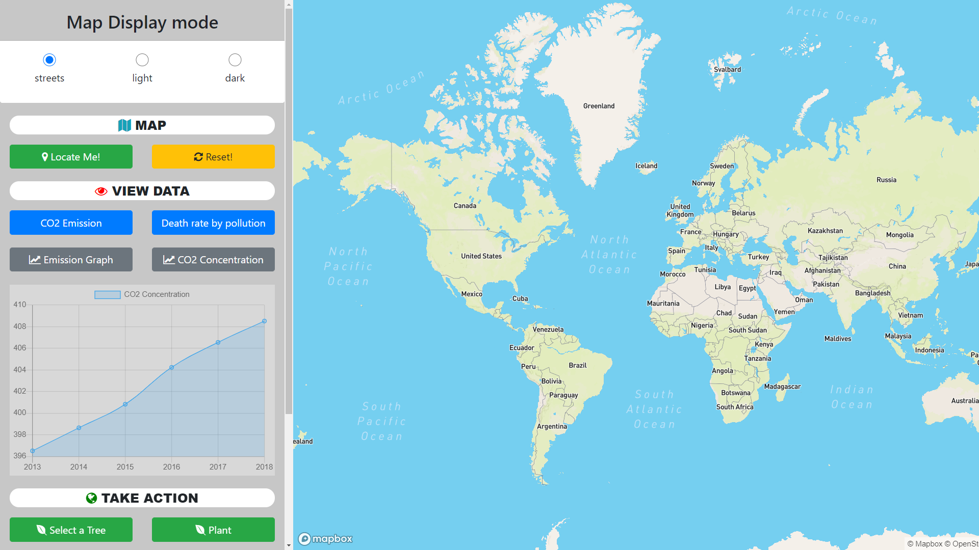
SOLUTION

Slide 14
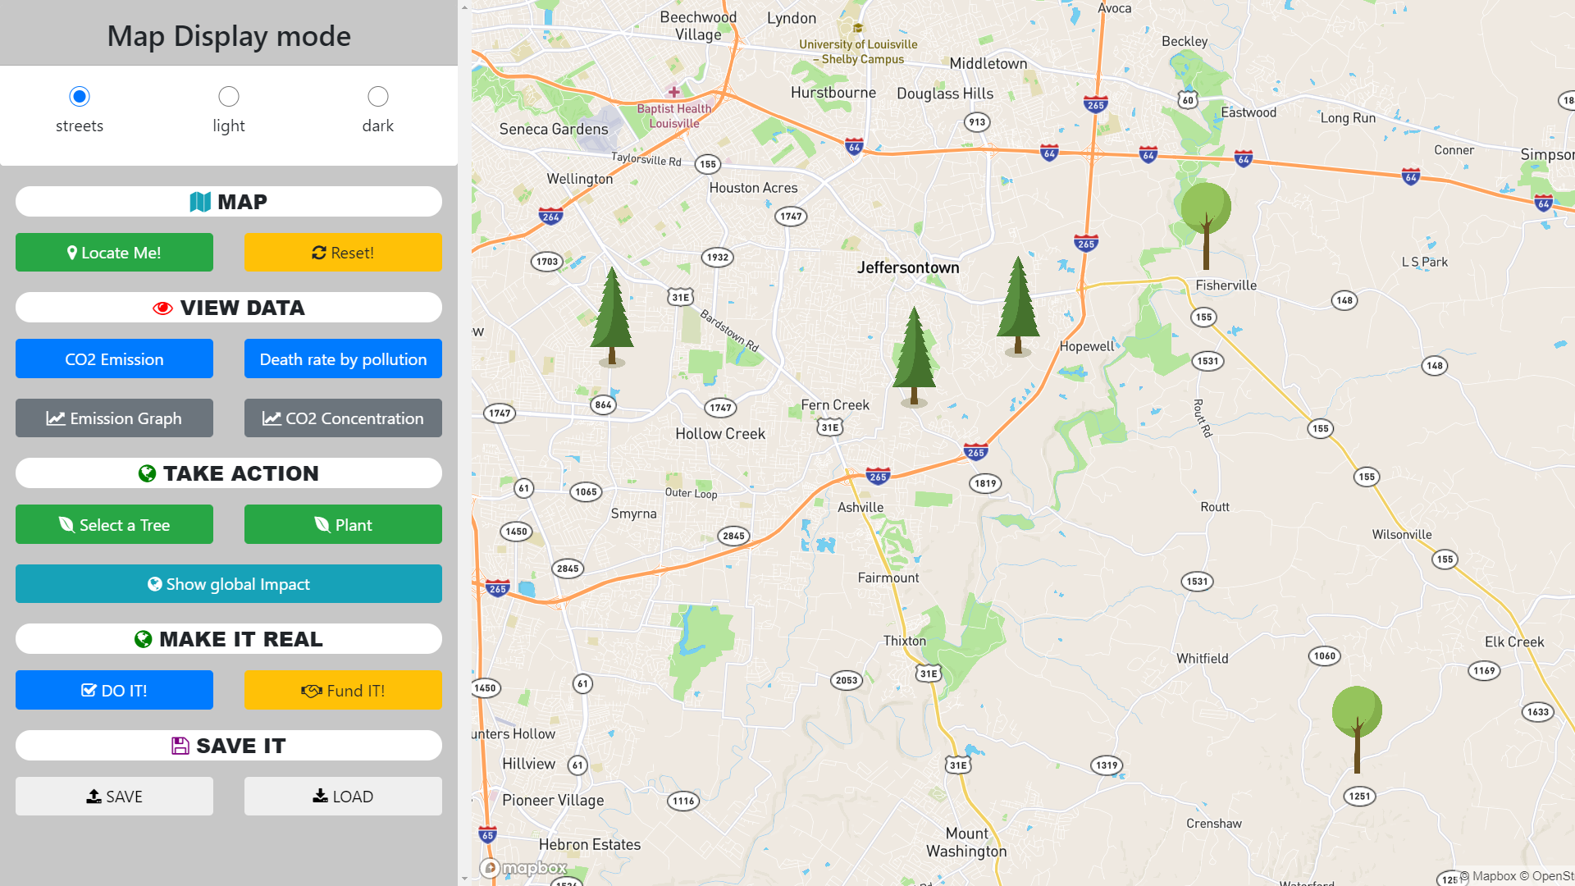
SOLUTION

Slide 15
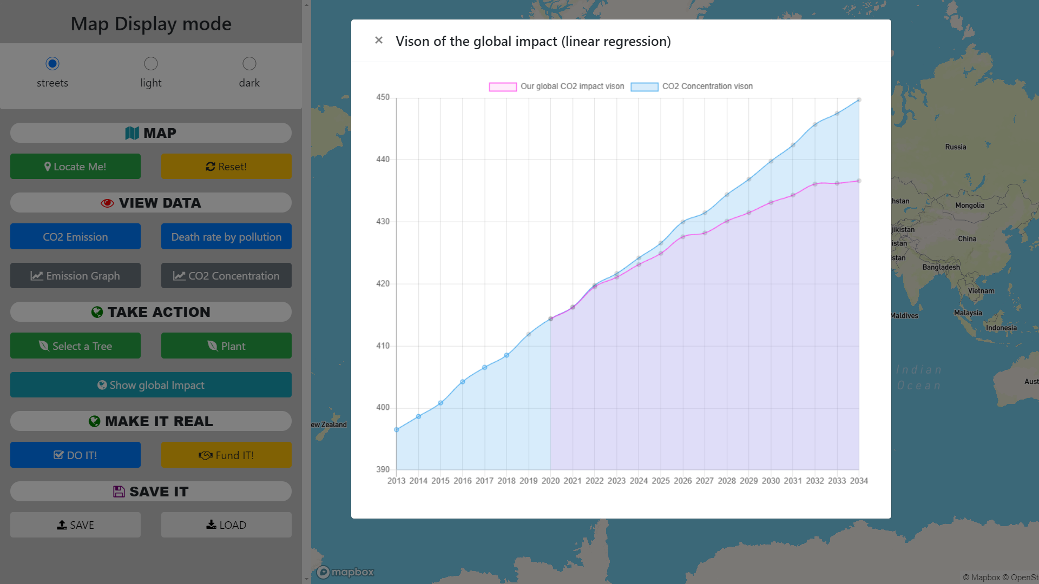
SOLUTION

Slide 16
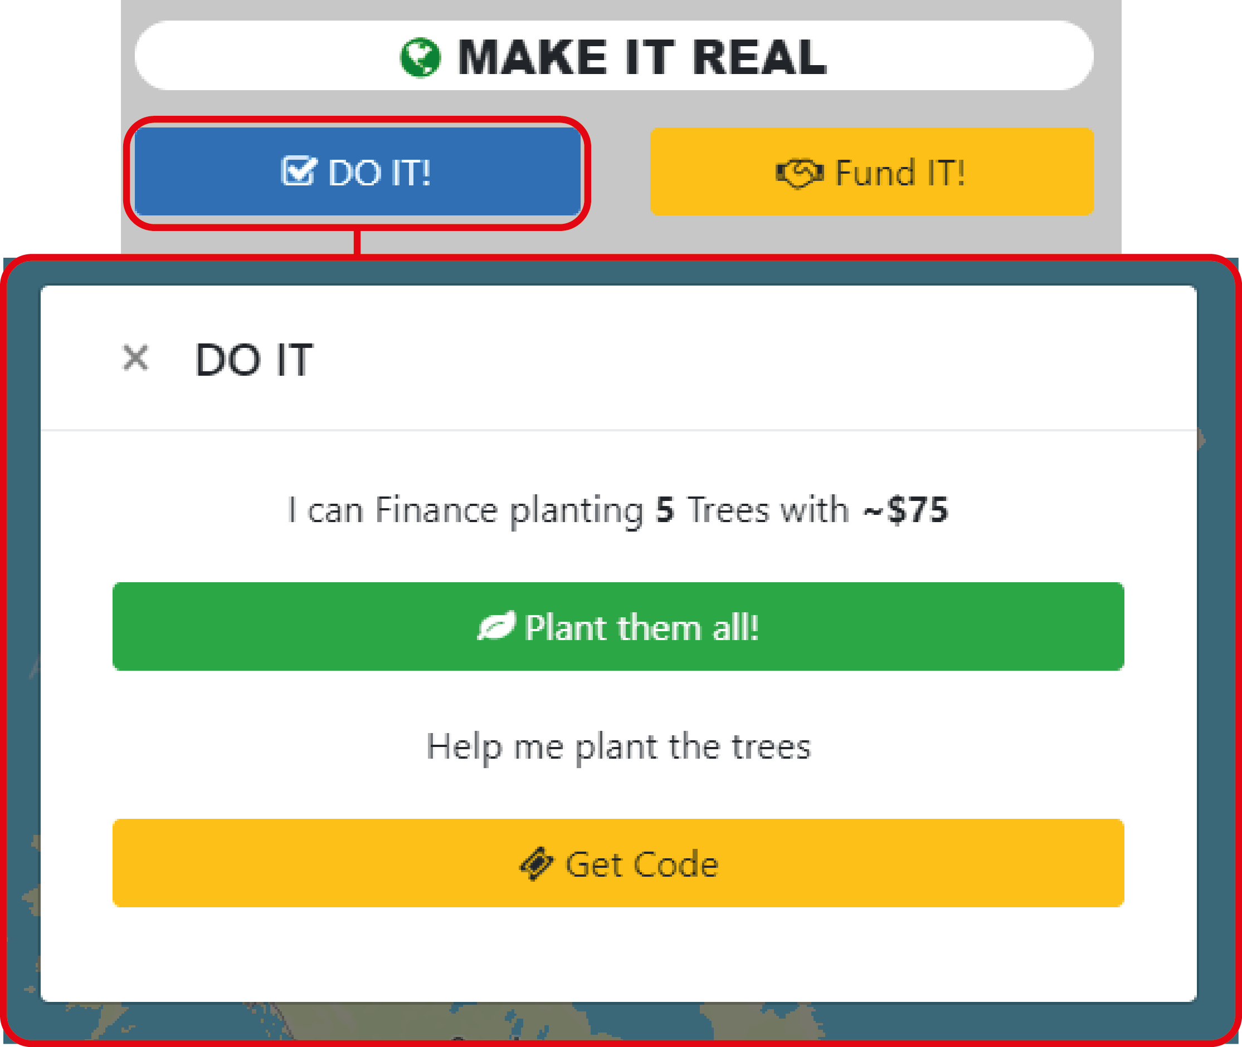
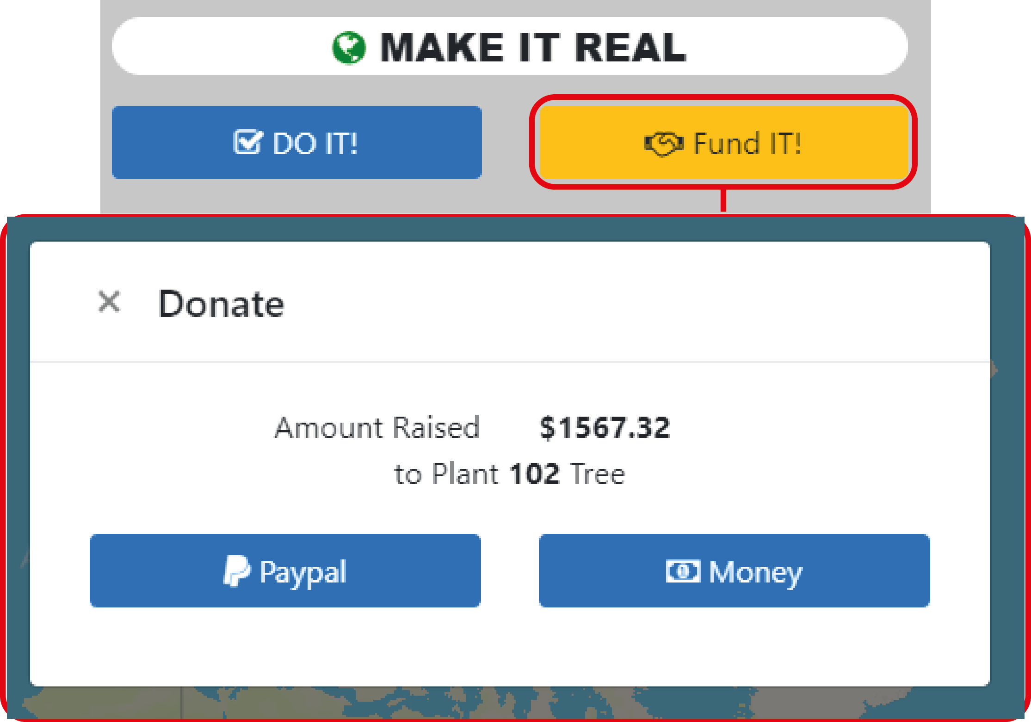
SOLUTION
16

Slide 17

SOLUTION

Slide 18


IMPACT
Awareness & Health
Lowering CO2
Sustaining The Planet
Communities

Slide 19

VISION

Slide 20

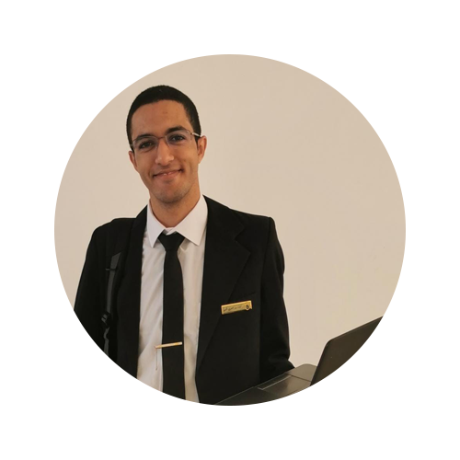
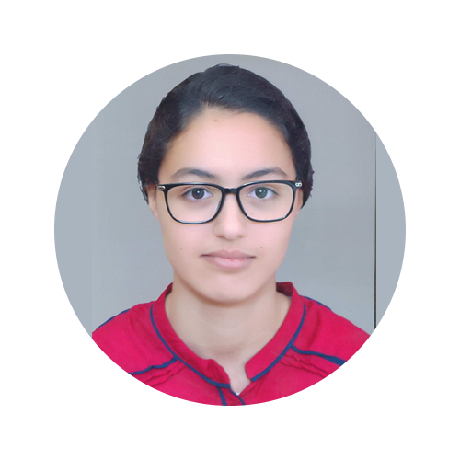
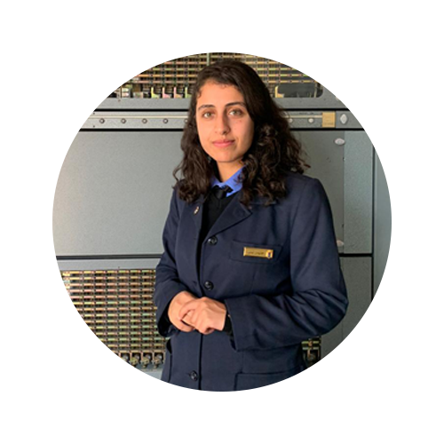

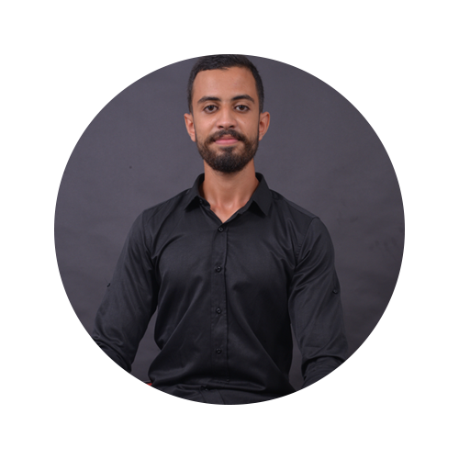
OUR TEAM
AIT BEN EL ARBI Anass
MASLOUHI Fadwa
ABERKA Soukaina
Take a step and let the future immortalize your actions.
JNIDAR Loubna
LALLEJ Najlae
HADANI Mohammed
20

Slide 21
SOURCES
https://www.respire-asso.org/dioxyde-de-carbone-co2/
https://ourworldindata.org/air-pollution
https://ourworldindata.org/atmospheric-concentrations
https://www.esrl.noaa.gov/gmd/ccgg/trends/data.html
https://ourworldindata.org/air-pollution

